Slide 1
CSE/PC/B/T/316 Computer Networks Topic 3- Multiple Access Protocols (ALOHA and Slotted ALOHA)
Sarbani Roy
sarbani.roy@jadavpuruniversity.in
Office: CC-5-7
Cell: 9051639328

Slide 2
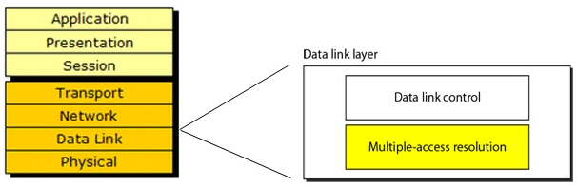
Data link layer divided into two functionality-oriented sublayers

Slide 3

Multiple Access
Broadcast link used in LAN consists of multiple sending and receiving nodes connected to or use a single shared link

Slide 4
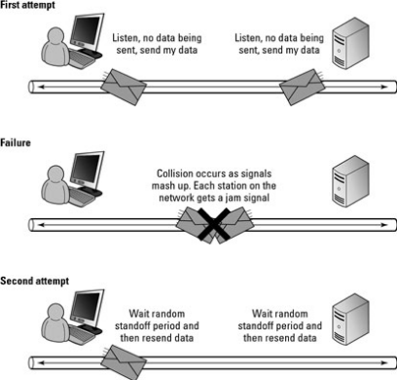
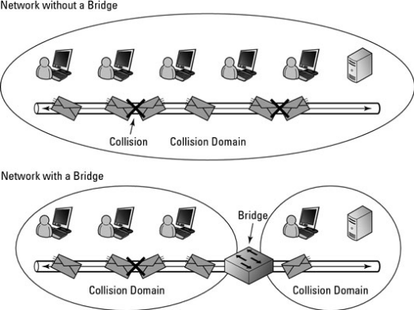
What is the problem?
When two or more nodes transmit at the same time, their frames will collide and the link bandwidth is wasted during collision

Slide 5
Problem: Coordination
How to coordinate the access of multiple sending/receiving nodes to the shared link???

Slide 6
Solution: MAC
Solution: We need a protocol to coordinate the transmission of the active nodes
These protocols are called Medium or Multiple Access Control (MAC) Protocols belong to a sublayer of the data link layer called MAC (Medium Access Control)

Slide 7
What is expected from MAC Protocols:
Main task is to minimize collisions in order to utilize the bandwidth by:
When a station can use the link (medium)? (Determining)
What a station should do when the link is busy?
What the station should do when it is involved in collision?

Slide 8
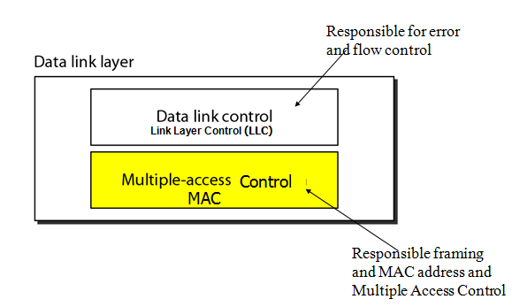
Data link layer divided into two functionality-oriented sublayers

Slide 9
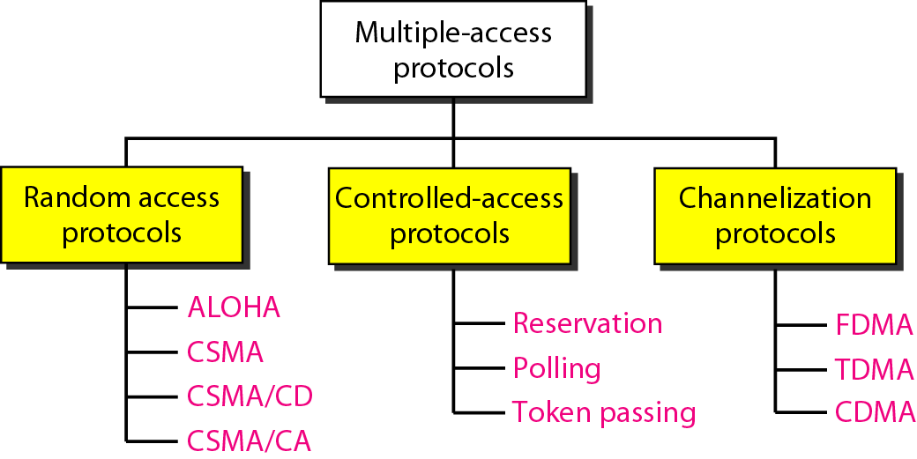
Taxonomy of multiple-access protocols

Slide 10
Random Access (or contention) Protocols
No station is superior to another station and none is assigned the control over another.
A station with a frame to be transmitted can use the link directly based on a procedure defined by the protocol to make a decision on whether or not to send.

Slide 11
Protocols
ALOHA
Carrier Sense Multiple Access (CSMA)
Carrier Sense Multiple Access with Collision Detection (CSMA/CD)
Carrier Sense Multiple Access with Collision Avoidance (CSMA/CA)

Slide 12
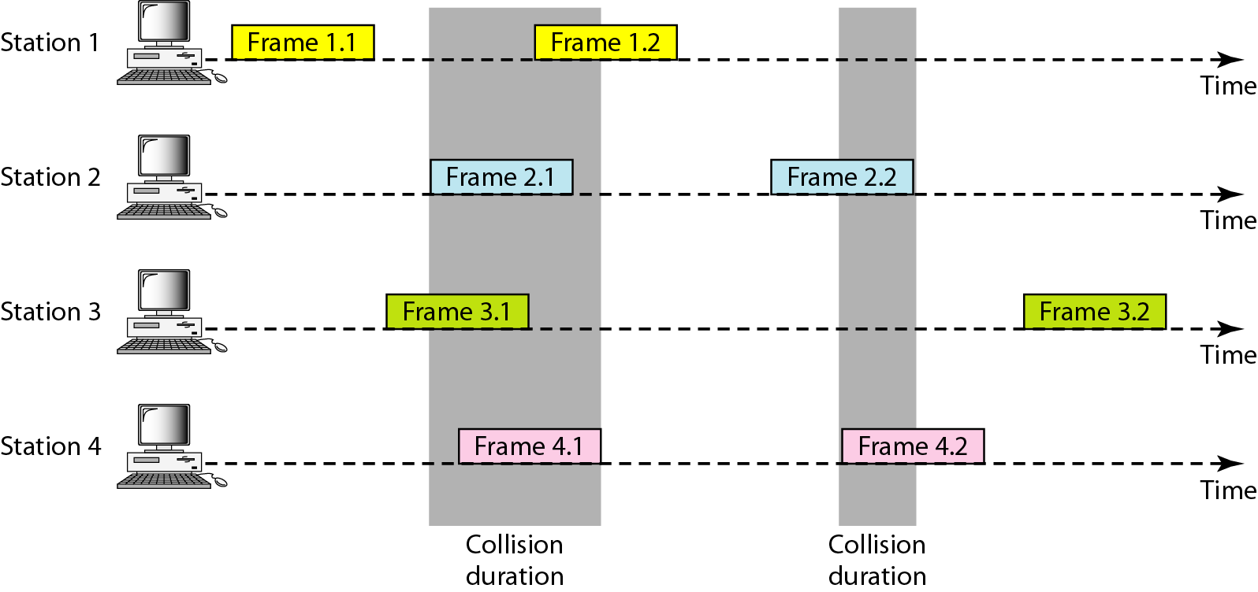
Frames in a pure ALOHA network
(Additive Links On-line Hawaii Area)

Slide 13
Pure ALOHA Protocol
If you have data to send, send the data
If, while you are transmitting data, you receive any data from another station, there has been a message collision. All transmitting stations will need to try resending "later".
Note that the first step implies that Pure ALOHA does not check whether the channel is busy before transmitting.
Since collisions can occur and data may have to be sent again, ALOHA cannot use 100% of the capacity of the communications channel.
How long a station waits until it transmits, and the likelihood a collision occurs are interrelated, and both affect how efficiently the channel can be used.
This means that the concept of "transmit later" is a critical aspect: the quality of the backoff scheme chosen significantly influences the efficiency of the protocol, the ultimate channel capacity, and the predictability of its behavior.

Slide 14
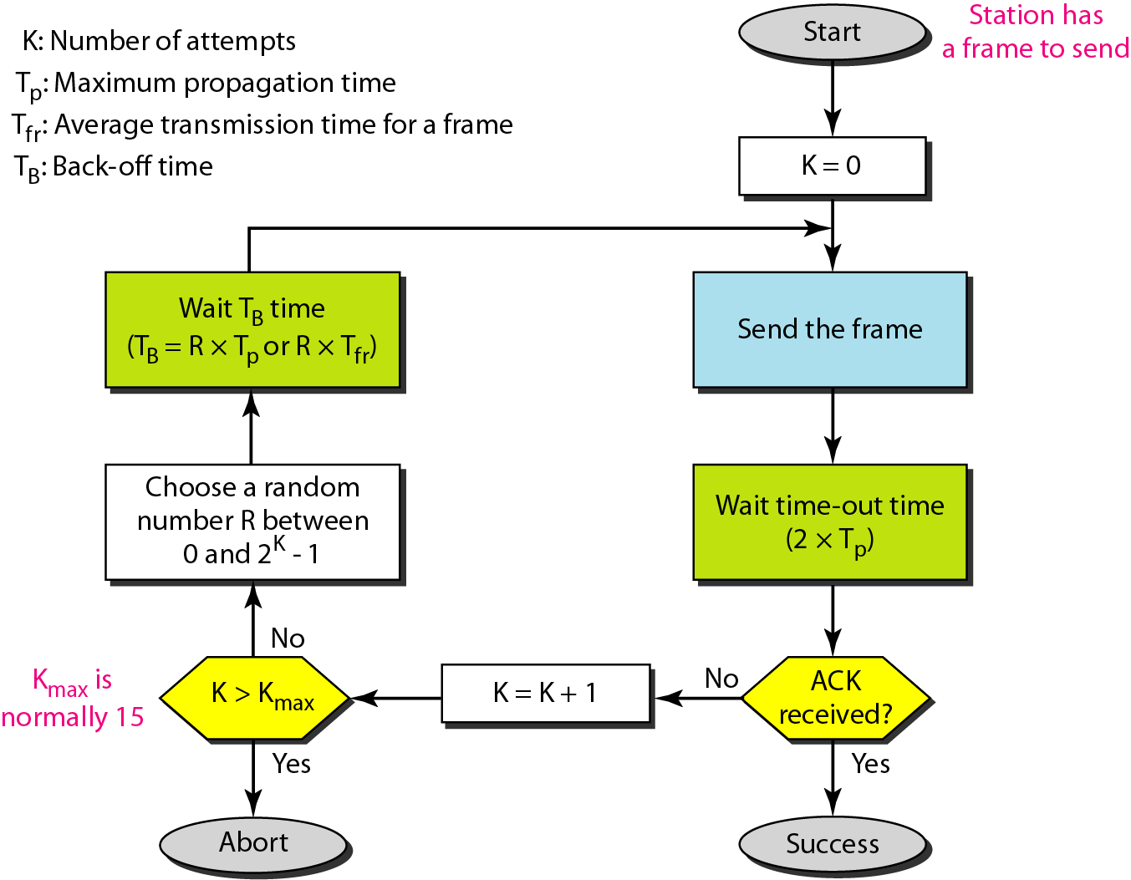
Procedure for pure ALOHA protocol

Slide 15
Throughput for pure ALOHA
To assess Pure ALOHA, there is a need to predict its throughput, the rate of (successful) transmission of frames. First, let's make a few simplifying assumptions:
All frames have the same length.
Stations cannot generate a frame while transmitting or trying to transmit. (That is, if a station keeps trying to send a frame, it cannot be allowed to generate more frames to send.)
The population of stations attempts to transmit (both new frames and old frames that collided) according to a Poisson distribution.

Slide 16

Throughput for pure ALOHA
The throughput can be calculated as the rate of transmission-attempts multiplied by the probability of success, and it can be concluded that the throughput (Spure) is:

Slide 17
Throughput for pure ALOHA
Let "T" refer to the time needed to transmit one frame on the channel, and let's define "frame-time" as a unit of time equal to T.
Let "G" refer to the mean used in the Poisson distribution over transmission-attempt amounts: that is, on average, there are G transmission-attempts per frame-time.
Consider what needs to happen for a frame to be transmitted successfully.
Let "t" refer to the time at which it is intended to send a frame. It is preferable to use the channel for one frame-time beginning at t, and all other stations to refrain from transmitting during this time.

Slide 18



Throughput for pure ALOHA
For any frame-time, the probability of there being k transmission-attempts during that frame-time is:
The average amount of transmission-attempts for 2 consecutive frame-times is 2G. Hence, for any pair of consecutive frame-times, the probability of there being k transmission-attempts during those two frame-times is:
Therefore, the probability (Probpure) of there being zero transmission-attempts between t-T and t+T (and thus of a successful transmission for us) is:

Slide 19
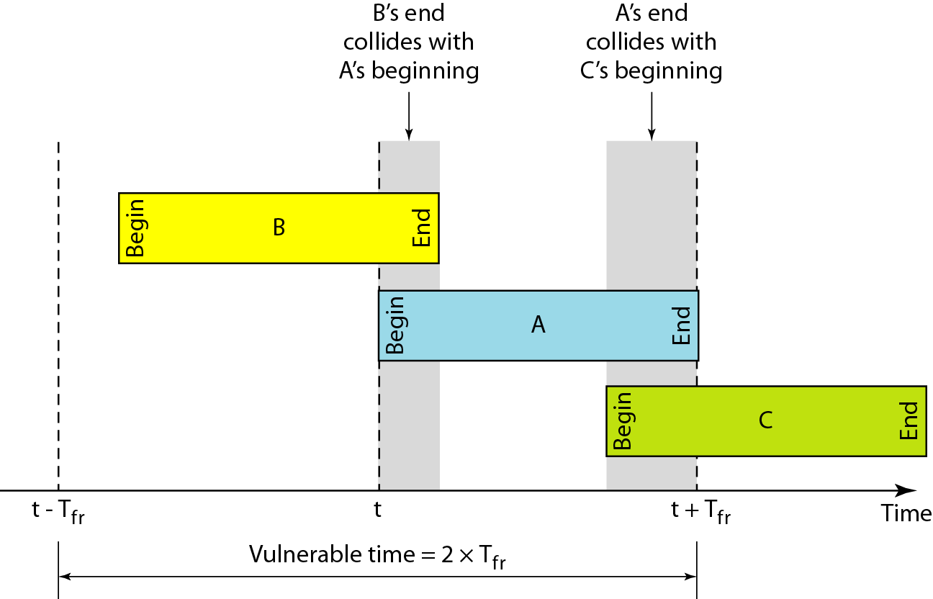
Vulnerable time for pure ALOHA protocol

Slide 20
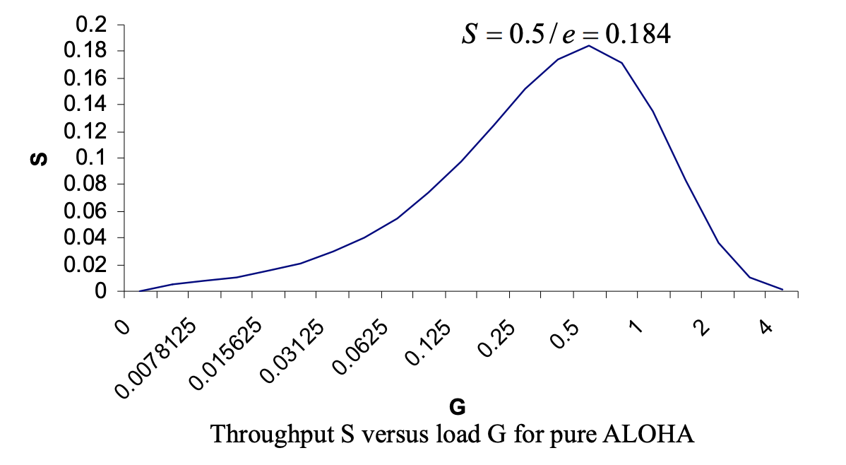
Throughput S versus load G for Pure ALOHA
The maximum throughput occurs at G = 0.5, which is approximately 0.18 frames per frame-time. This means that, in Pure ALOHA, only about 18% of the time is used for successful transmissions i.e., 82% of frames end up in collisions and are therefore lost.

Slide 21
Disadvantages of Pure ALOHA
Time is wasted
Data is lost
Now think …how we can improve

Slide 22
Frames in a pure ALOHA network

Slide 23
Vulnerable time for pure ALOHA protocol

Slide 24
Slotted ALOHA
Pure ALOHA has a vulnerable time of 2Tfr
This is so because there is no rule that defines when the station can send.
A station may send soon after another station has started or soon before another station has finished.
Slotted ALOHA was invented to improve the efficiency of pure ALOHA.

Slide 25
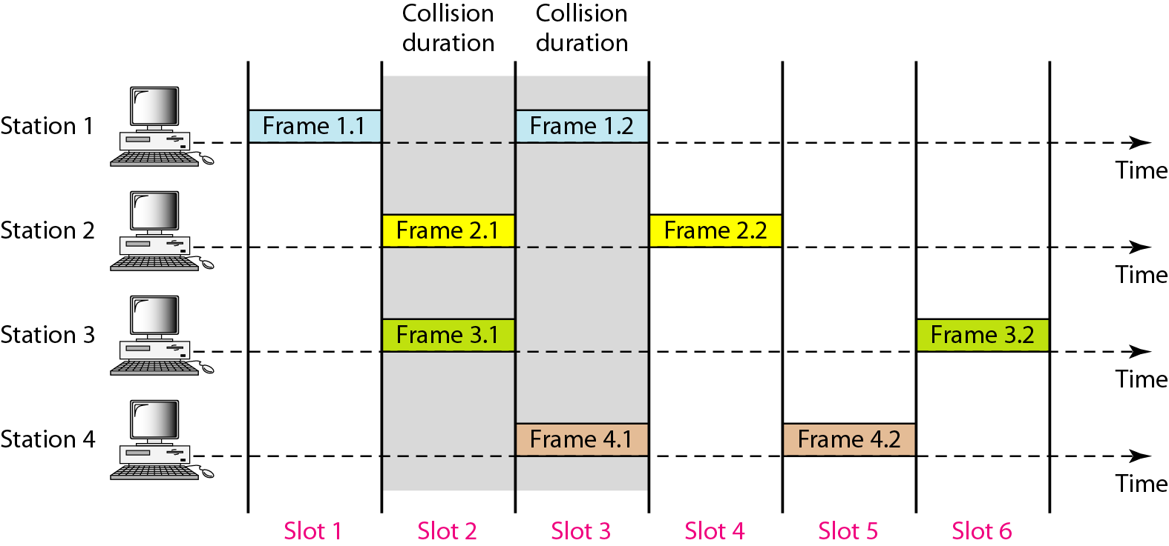
Frames in a slotted ALOHA network

Slide 26
Slotted ALOHA
A station can start a transmission only at the beginning of a timeslot, and thus collisions are reduced. In this case, only transmission-attempts within 1 frame-time and not 2 consecutive frame-times need to be considered, since collisions can only occur during each timeslot. Thus, the probability of there being zero transmission-attempts by other stations in a single timeslot is:
The probability of a transmission requiring exactly k attempts is (k-1 collisions and 1 success)
The throughput is:

Slide 27
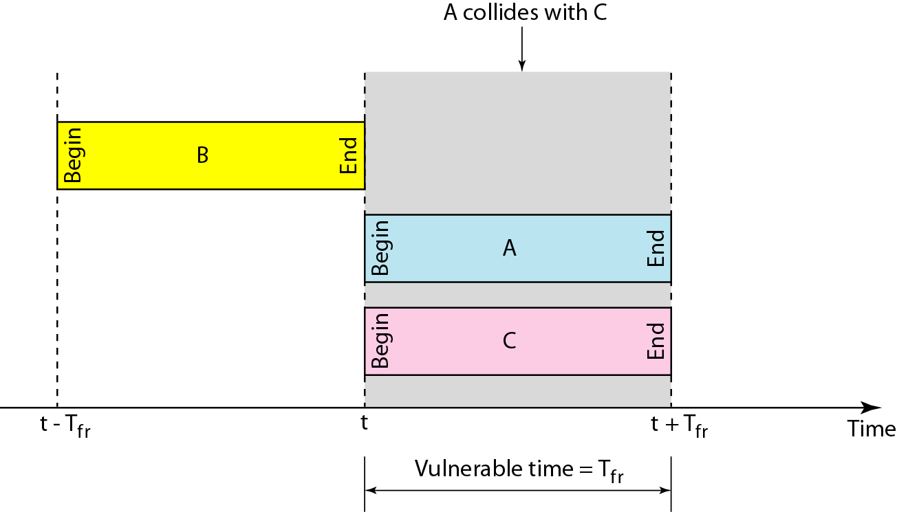
Vulnerable time for slotted ALOHA protocol

Slide 28
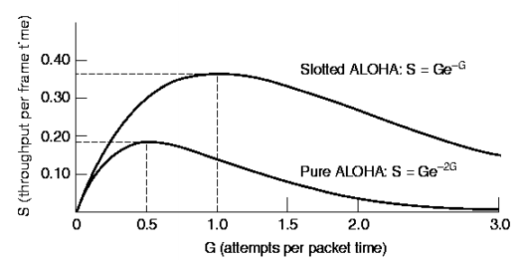
The throughput for slotted ALOHA is S = G × e^{−G} .
The maximum throughput S_{max} = 0.368 when G = 1.

Slide 29
Comparison
BASIS FOR COMPARISON | PURE ALOHA | SLOTTED ALOHA
Introduced | Introduced by Norman Abramson and his associates at the University of Hawaii in 1970. | Introduced by Roberts in 1972.
Frame Transmission | The user can transmit the data frame whenever the station has the data to be transmitted. | The user has to wait till the next time slot start, to transmit the data frame.
Time | In Pure ALOHA the time is continuous. | In Slotted ALOHA the time is discrete.
Successful Transmission | The probability of successful transmission of the data frame is: S= G* e^-2G | The probability of successful transmission of the data frame is: S= G*e^-G

Slide 30
Synchronization | The time is not globally synchronized. | The time here is globally synchronized.
Throughput | The maximum throughput occurs at G = 1/2 which is 18%. | The maximum throughput occurs at G = 1 which is 37%.
Application | Aloha was the basis for Ethernet, a local area network protocol | Slotted ALOHA is used in low-data-rate tactical satellite communications networks by military forces, in subscriber-based satellite communications networks, mobile telephony call setup, set-top box communications and in the contactless RFID technologies.

Slide 31
Problem -1
Assume that the stations on a wireless ALOHA network are a maximum of 600 km apart. Now find T_{p}, T_{b} for different values of K.

Slide 32
Solution
The stations on a wireless ALOHA network are a maximum of 600 km apart. If we assume that signals propagate at 3 × 10⁸ m/s, we find
Tp = (600 km ) / (3 × 10⁸ m/s) = 2 ms.
Now we can find the value of T_{B} for different values of K .

Slide 33
Solution …contd
For K = 1, the range is {0, 1}. The station needs to generate a random number with a value of 0 or 1. This means that T_{B} is either 0 ms (0 × 2) or 2 ms (1 × 2), based on the outcome of the random variable.
For K = 2, the range is {0, 1, 2, 3}. This means that T_{B} can be 0, 2, 4, or 6 ms, based on the outcome of the random variable.
For K = 3, the range is {0, 1, 2, 3, 4, 5, 6, 7}. This means that T_{B} can be 0, 2, 4, . . . , 14 ms, based on the outcome of the random variable.
We need to mention K is normally set to 10.

Slide 34
Problem - 2
A pure ALOHA network transmits 200-bit frames on a shared channel of 200 kbps. What is the requirement to make this frame collision-free?

Slide 35
Solution
Average frame transmission time T_{fr} is 200 bits/200 kbps or 1 ms. The vulnerable time is 2 × 1 ms = 2 ms. This means no station should send later than 1 ms before this station starts transmission and no station should start sending during the one 1-ms period that this station is sending.

Slide 36
Problem -3
A pure ALOHA network transmits 200-bit frames on a shared channel of 200 kbps. What is the throughput if the system (all stations together) produces
a. 1000 frames per second b. 500 frames per second c. 250 frames per second.

Slide 37
Solution
The frame transmission time is 200/200 kbps or 1 ms.
a. If the system creates 1000 frames per second, this is 1 frame per millisecond. The load is 1. In this case S = G× e−2 G or S = 0.135 (13.5 percent). This means that the throughput is 1000 × 0.135 = 135 frames. Only 135 frames out of 1000 will probably survive.
b. If the system creates 500 frames per second, this is (1/2) frame per millisecond. The load is (1/2). In this case S = G × e −2G or S = 0.184 (18.4 percent). This means that the throughput is 500 × 0.184 = 92 and that only 92 frames out of 500 will probably survive. Note that this is the maximum throughput case, percentagewise.

Slide 38
c. If the system creates 250 frames per second, this is (1/4) frame per millisecond. The load is (1/4). In this case S = G × e ^−2G or S = 0.152 (15.2 percent). This means that the throughput is 250 × 0.152 = 38. Only 38 frames out of 250 will probably survive.

Slide 39
Problem -4
A slotted ALOHA network transmits 200-bit frames on a shared channel of 200 kbps. What is the throughput if the system (all stations together) produces
1000 frames per second b. 500 frames per second c. 250 frames per second.

Slide 40
A slotted ALOHA network transmits 200-bit frames on a shared channel of 200 kbps. What is the throughput if the system (all stations together) produces
1000 frames per second b. 500 frames per second c. 250 frames per second.
Solution
The frame transmission time is 200/200 kbps or 1 ms.
a. If the system creates 1000 frames per second, this is 1 frame per millisecond. The load is 1. In this case S = G× e^{−G} or S = 0.368 (36.8 percent). This means that the throughput is 1000 × 0.0368 = 368 frames. Only 386 frames out of 1000 will probably survive.

Slide 41
b. If the system creates 500 frames per second, this is (1/2) frame per millisecond. The load is (1/2). In this case S = G × e^{−G} or S = 0.303 (30.3 percent). This means that the throughput is 500 × 0.0303 = 151. Only 151 frames out of 500 will probably survive.
c. If the system creates 250 frames per second, this is (1/4) frame per millisecond. The load is (1/4). In this case S = G × e ^{−G} or S = 0.195 (19.5 percent). This means that the throughput is 250 × 0.195 = 49. Only 49 frames out of 250 will probably survive.

Slide 42
Problem -5
Suppose that a radio system uses a 9600 bps channels for sending call setup request messages to a base station. Suppose that packets are 120 bits long. What is the maximum throughput possible with ALOHA and with slotted ALOHA?

Slide 43
The system transmits packets at a rate =
(9600 bits/second) x (1 packet/120bits) = 80 packets/second.
The maximum throughput for ALOHA =
80 x (0.184) ≈ 15 packets/second
The maximum throughput for slotted ALOHA =
80 x (0.368) ≈ 30 packets/second

